Slide 1
a sample project

Slide 2
Learning system
Here are our business requirements from the Functional Analyst:
A student visits the solution and logs in. He or she is presented with a list of courses. When a student clicks a course, he or she is taken directly to the last visited lecture in that course. The lecture detail page has 3 panels and shows the curriculum on the left, the lecture contents in the middle, and a Q & A panel on the right. The student can use the curriculum to navigate to different lectures and submit questions to the instructor in the Q & A panel.
An instructor visits the solution and logs in. He or she is presented with a list of courses. When the instructor clicks on a course, he or she is taken directly to a course management page. The page shows all questions in the course, with the unanswered questions highlighted. By clicking on a question, the instructor navigates to a new page where he or she can answer the question.

Slide 3
Learning system
And here are our business requirements from the CTO:
Basically, our key attributes are:
Performance
Availability
Scalability
Lectures need to load in 1 second or less. Performance is key, our USP is to be the fastest platform in the business, and our students and instructors will abandon our platform if we are too slow. We also cannot afford to be offline. Every hour we are offline would cost our business thousands of dollars in lost revenue. And we want to scale to millions of students, the platform must be able to accommodate for that with ease.

Slide 4
initial design
We have not learned about architecture patterns yet
So, it's a bit premature to start creating a detailed design
But we know about the process and can get started with our initial diagrams
Our tasks for now are in the first 3 steps of the design process:
1a. What are our objectives? What are our scopes?
1b. Who is the key audience? Any constraints?
2a. What are the key business scenarios? Create a Use Case diagram.
2b. Create an Activity diagrams for the student and the instructor.
3a. Think about the architectural overview. What is the application type?
3b. Decide the technology stack. Back-end? Front-end?
You can use https://draw.io or https://lucid.co/product/lucidchart for the diagrams

Slide 5
Scope and objectives
The scope of this architecture contains:
Login screen for both student and instructor
Student interface for listing courses
Watching course lectures
Q & A panel for submitting questions
Instructor interface for listing courses
Course management page
Q & A panel for answering student questions
Time schedule – 1 week
Audience – CTO and Developers
We can easily include technical stuff

Slide 6
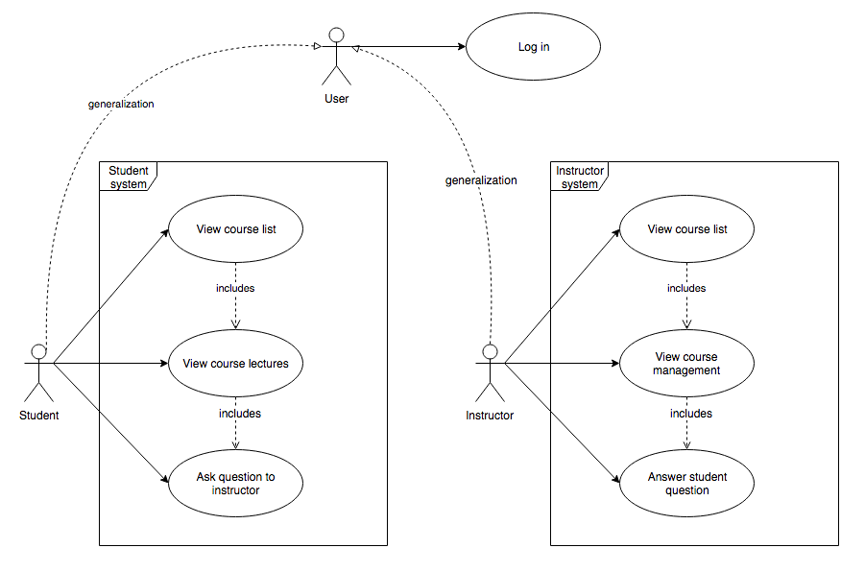
key scenarios Use case diagram example

Slide 7
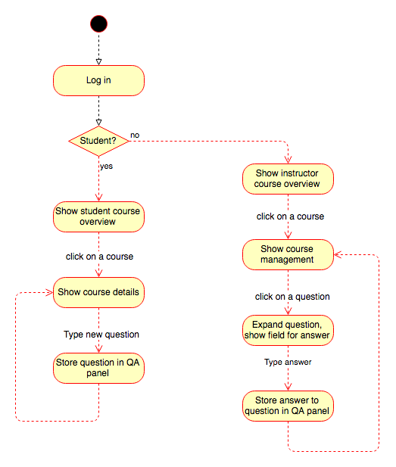
key scenarios activity diagram example

Slide 8
Technology constraints
We are building the solution from scratch
We choose technologies based on our and the developer skills
There is no need to introduce an unfamiliar stack – it will increase the expenses of the project
If you are still building the team – you can experiment a bit more
I am proficient with .NET and JavaScript
And my team is consisting of very skilled .NET developers
My technology stack will be Microsoft oriented
We want millions of students and huge availability
On premises servers will require huge maintainability
We are going to use a public cloud
Azure is the perfect choice for Microsoft technology
But consider the other options as well – they may be cheaper

Slide 9
technology options
Back-end technology options:
ASP.NET Core REST API – requires heavy server-side architecting
Serverless with Azure Functions – less architecture burden but less overall control
Front-end technology options:
ASP.NET Core MVC
Server-side rendering is not very suitable for interactive applications
ASP.NET Core Razor Pages
Less overhead in terms of the client
Blazor
Way too new and experimental but the developers may want the bleeding edge
React or Vue
Depends on the knowledge of the developers

Slide 10
Architecture design patterns

Slide 11
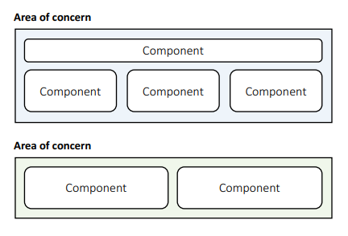
Component-based Pattern - Structural
Components are modular building blocks of software
Grouped into areas of concern
Clearly described interfaces
Containers provide additional services
Pros:
Easy deployment & Allows 3rd party tools
Promotes modularity & Few unanticipated interactions
Cons:
Coarse building blocks & Can be expensive
Initialization may be slow & Harder to develop & maintain

Slide 12
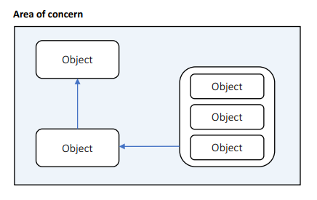
Object-Oriented Pattern - Structural
Uses classes
Grouped into areas of concern
Describes public members
Uses inheritance, composition, aggregation, and associations
Pros:
Easy to understand & Promotes reuse
Easy to test & debug & Highly cohesive
Cons:
Inheritance hard to get right & Useful only if you do not have a Lead Developer
Many unanticipated communications & Too detailed

Slide 13
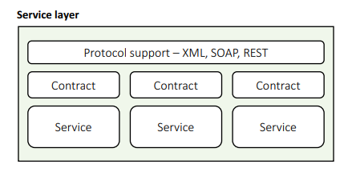
Service-Oriented Pattern - Service
Discrete business services
Use network to communicate
HTTP, XML, SOAP, Binary…
Pros:
Business domain alignment & High abstraction
Discoverable, resilient, Allows 3rd party libraries & Cross-platform
Cons:
Clients must handle slow, offline network
Coarse interfaces
May harm performance
Security issues

Slide 14
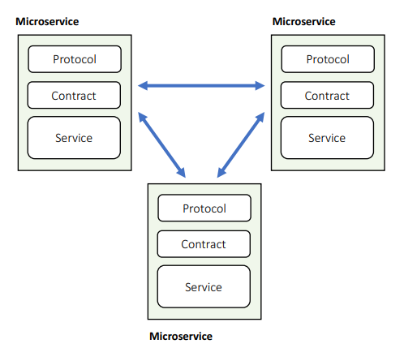
Microservice Pattern - Service
Services calling services
Can use fast private network and RPC
Deployed on multiple servers
Pros:
Modular & Reduced abstraction
Discoverable, resilient & Less coarse interfaces
Can use fast network
Cons:
Must cope with slow, offline network
More unanticipated communications
Hard to do transactions & Hard to test, debug, deploy

Slide 15
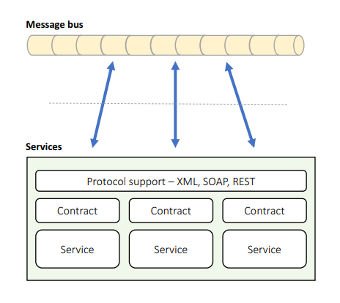
Message Bus Pattern - Service
Services connected to shared data bus
Uses messages for communication
Supports discovery, failover
Pros:
Easy to extend & Simple communication
Very flexible & Easy to scale
Easy discovery, failover
Cons:
Bus = single point of failure
Coarse communications
Can be slow & Hard to test, debug

Slide 16
Mixing of patterns
A software architecture is just a mixture of patterns
You can safely nest architectural design pattern inside of each other
For example:
Microservices with components inside them
Microservices with a layered pattern inside them
Create your own hybrid patterns and use them in your design
If the pattern works for you, implement it!

Slide 17
Questions for the learning system
We already chosen an application type and the technology stack
We need to pick architectural pattern and draw a diagram
1a. Choose an architectural design pattern. A great place to start is the layered pattern.
1b. Create a diagram with presentation, service, business, data and systemwide layers.
1c. Choose a pattern for the presentation layer. MVC? MVVM? Components?
2a. Consider authentication, caching, communication, configuration, logging, exceptions and validation.
2b. Consider all third-party tools to help you with these cross-cutting concerns.
3a. This is our first baseline architecture. Think about the components in the layers.
3b. Create diagrams for each layer and describe their public interfaces.
3c. Make sure you keep it simple at this stage. You can go into more detail in later cycles.
4. Design the business domain entities. Create a class diagram and define their public properties.

Slide 18
Choosing the right patterns

Slide 19
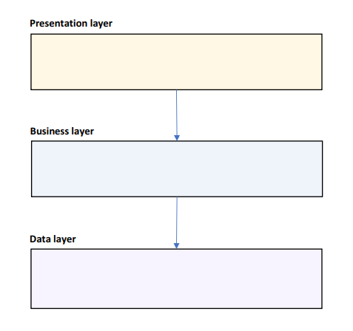
The Layered Pattern
Good starting point
Create 3 layers:
UI / Presentation – visualization concerns
Business – business logic and domain
Data – data access layer
If you expect a long-term project, you may choose Domain-Driven Design with Clean Architecture
Presentation – visualization concerns
Application – business logic
Infrastructure – infrastructure details
Domain – business entities
Add a Service layer if you plan to expose an API

Slide 20
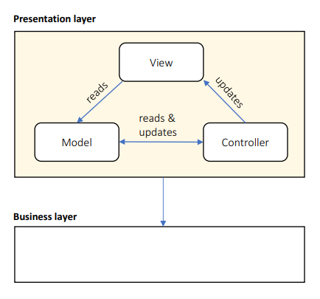
The Presentation Layer
Use Components for:
Containers
Reuse
3rd parties
Declarative rendering
Like WordPress – with widgets
Or with visual designer
Lots of dynamic interactions
Use MVC for lots of UI pages
Or MVVM if the technology support data binding
Remove this layer, if you designing an API
Without any UI

Slide 21
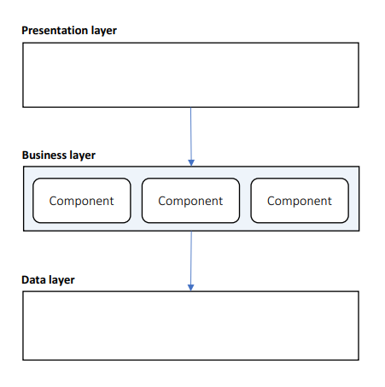
The Business Layer
Use Components:
Modular functionality
Plugin support
Business entity abstraction
For each entity – create a component
Declarative configuration:
Visual workflows – like a flow chart for the business rules
Business rules – collection of if/then/else rules
If you don’t need the above, use an object-oriented architecture

Slide 22
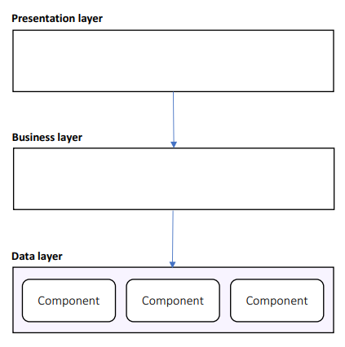
The Data Layer
Use Components:
Handling diverse data sources
SQL Server, Redis, MongoDB, etc.
Increased abstraction
Declarative configuration
Easily replace connection string, data storages and other mechanisms

Slide 23
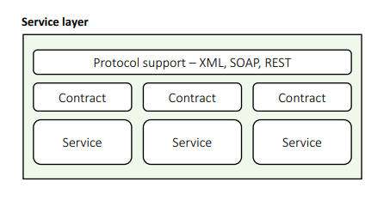
The service Layer
Use Components:
Contract management
Containers
Declarative configuration
Choose Microservices if your system is composed mostly of interlocking APIs
Never start with Microservices
Always choose a monolithic application with Microservices in mind
Use Domain-Driven Design and Clean Architecture to separate contexts
Extract microservices when necessary
Choose Message Bus if all services alter state on a common message

Slide 24
Designing Component Architectures

Slide 25
General Guidelines
Components are SOLID:
Single Responsibility
Open/Closed
Liskov Substitution
Interface Segregation
Dependency Inversion
Highly cohesive
Define clear naming rules
Classes, interfaces, methods, variable, constants, etc.
No knowledge of internals of other components

Slide 26
Design patterns
Design patterns are micro-architecture
Make sure your developers are familiar with them
Commonly useful design patterns:
Factory – remove the "new is glue" syndrome from your code
Repository – only if you really need it, may serve as anti-corruption layer
Façade – hide complexity in your business logic
Command – encapsulate actions in objects
Strategy – supports open/close principle
Learn all of them!
But use only the ones you need!

Slide 27
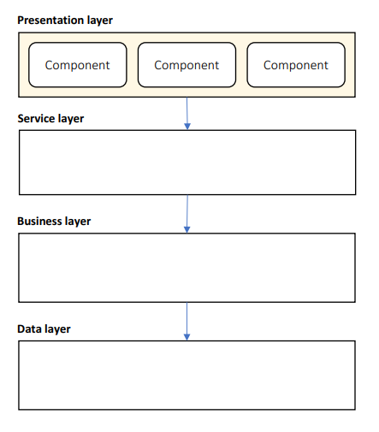
Presentation Layer Components
UI components
Presentation Logic
Views
Controllers
View Models
Optional:
Presentation entities

Slide 28
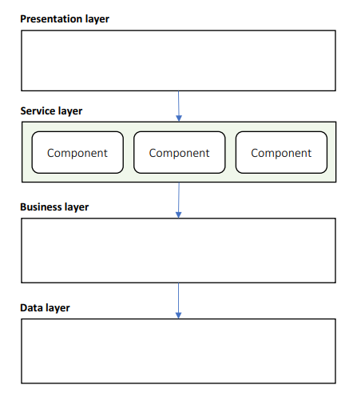
Service Layer Components
Services
Service Interfaces
Message Types
Data Transfer Objects
Optional:
Message Broker

Slide 29
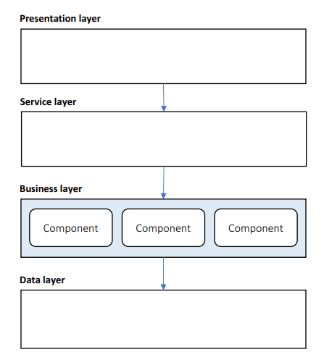
Business Layer Components
Business Façade
Business Logic
Components
Workflows
Business Rules
Business Entities
Populated through ORM
Or data objects from data layer
Business Events

Slide 30
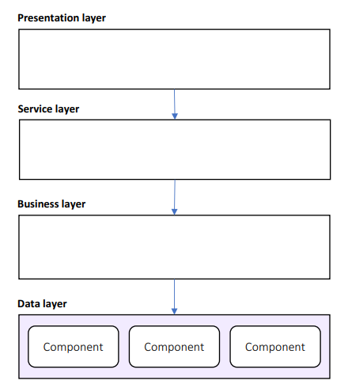
Data Layer Components
Data Façade
Data Source Adapters
Service Adapters
Optional:
Data Objects
Command & Query objects

Slide 31
Designing Service-Oriented Architectures

Slide 32
Rest service
CRUD operations
Operates on Entities
Content negotiation
JSON, XML, HTML, Markdown…
Low overhead
Using web servers and HTTP
Request/Response
No discovery & routing
Incomplete standard
Fairly new

Slide 33
SOAP service
Any operations
Not limited to Entities
XML
High overhead
More interface layers
Request/Response, Fire & Forget, Bi-Directional Calls
Standard discovery & routing
World standard
You usually use it with older and legacy systems

Slide 34
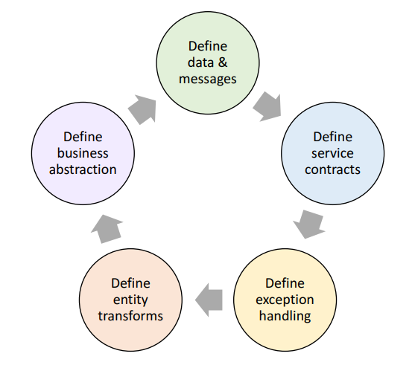
The Service Design Process
Define data & messages
Define service contracts
Plan exception handling
Define how business entities are transformed to messages
Define how business functions are abstracted to services

Slide 35
Define Service Messages
Request/Response, Fire & Forget, or Bi-Directional
Command, Query, Document, Entity, Event, Message…
Avoid large messages
Add expiration & diagnostic info
Define in a Class Diagram

Slide 36
Define Service Contracts
CRUD or RPC
Stateful/Stateless
Transaction Management
Handle invalid calls:
Timeouts
Duplicate calls
Calls out of order
Define in a Component Diagram

Slide 37
Plan Exception Handling
Only catch what you can handle
Use meaningful messages:
Business explanation
Technical information
Retry instructions
Return fault metadata
Log everything
Notify exception subscribers

Slide 38
Define Business Entity Transforms
Transform entities to messages:
Reference Business layer directly
Use an Object Mapper
Use an Object-Relational Mapper
Use a Transform Language
Custom-built
Considerations:
Narrowing/Widening transforms
Flattening/Elevating transforms
Reversible transforms

Slide 39
Define Business Abstraction
Business layer abstractions:
Call the Façade directly
Call Business Components
(Re)Start a Workflow
Log a Business Event
Considerations:
Long-running workflows
State management
Transactions

Slide 40
Questions for the learning system
We can now move within a new cycle and create our first candidate solution
Objectives and key scenarios stay the same but let's refine the architecture
1a. Are we happy with our layers? Remove or merge layers? Their communication?
1b. Revisit the key issues and the system-wide layer. Are we happy with them? Our third-party tools?
2a. Are we happy with our presentation layer? Do we want to add presentation entities?
2b. Are we happy with our business layer? Choose a mapping strategy.
2c. Are we happy with our data layer and the level of abstraction?
3a. Start filling the service layer. Choose REST or SOAP. Choose exception handling strategy.
3b. Describe service messages. Create a new UML class diagram describing public properties.
3c. Describe the service contracts and their public interfaces.
3d. Decide how the service layer will communicate with the business components. 3e. Choose a transformation engine.
4. Bonus – forward engineer a skeleton solution.

Slide 41
Architecture quality attributes

Slide 42
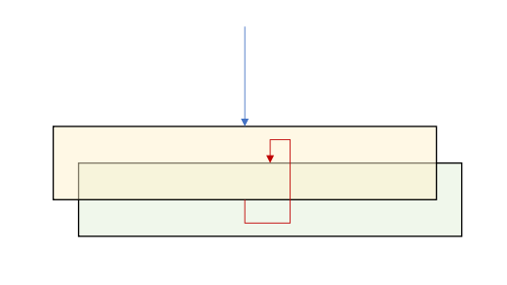
Conceptual Integrity – Design time
Isolated layers and components
Application lifecycle management
How to manage updates
Healthy team collaboration
Awesome relationship with the Lead Developer
Design and coding standards
Automate the in your code reviews
Break away from legacy designs:
Façade pattern
Wrap as service
Rebuild from scratch

Slide 43
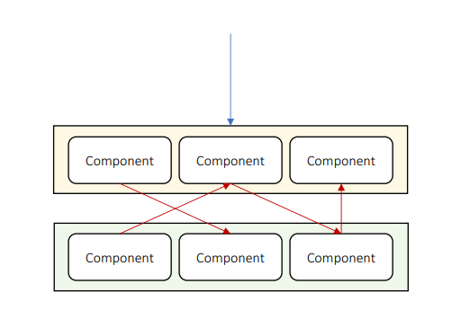
Maintainability – Design time
Isolated layers and components
Structured communication
Follow the same pattern for the whole solution
Consider a plugin system
Rely on platform features
Most modern languages have a lot to offer
Use systemwide layer
Add unit tests
Documentation

Slide 44
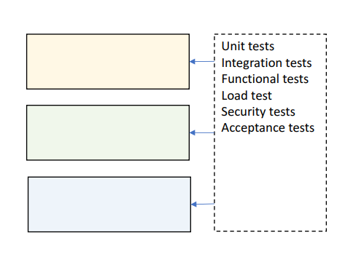
Testability – Design time
Design for testing
Allow mocking
Cover all layers
Automate case studies
Test:
Individual components
Entire layers
Collaboration between layers
Load, Security…

Slide 45
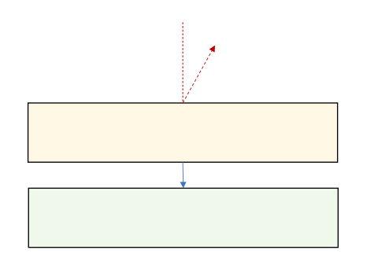
Availability – Runtime
Tier failover
Use rate limiter
Limits the number of calls per second
Short-lived resources locks
Or no locks at all, if that is possible
Recover from exceptions
Do not kill an entire tier with a single exception
Update-friendly architecture
Handle network faults:
Offline support
Buffered proxy

Slide 46
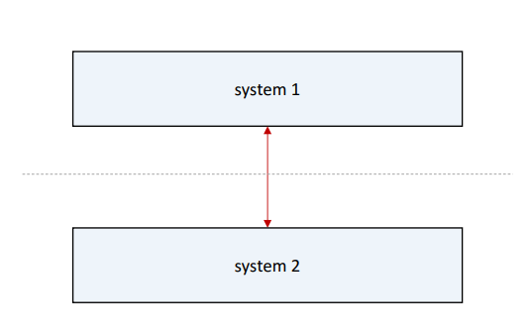
Interoperability – Runtime
Data transformation
Keep systems separate
Adhere to standard:
SOAP
REST
XML/JSON

Slide 47
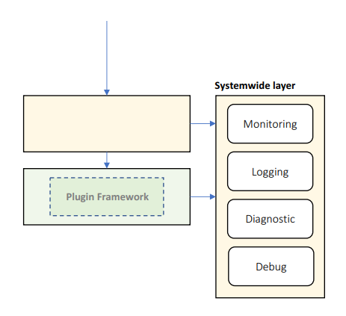
Manageability – Runtime
Health monitoring, logging, and diagnostic tracing
Consider a plugin or modular system
Much more flexible development
Declarative configuration
Add diagnostic tools:
Live tracing
Diagnostic notifications
Runtime log inspection
Runtime debugging
Dangerous so use it only in critical situations

Slide 48
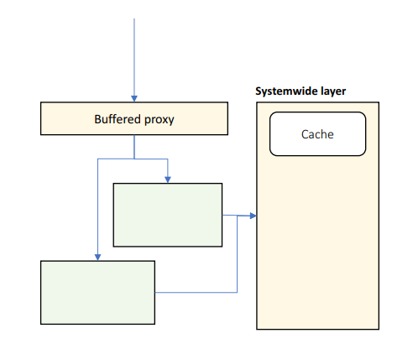
Performance – Runtime
Buffered proxy
Async responses
The client gets immediate response with progress bar
Load-balanced tiers
Caching
Load tests
Minimize throughput:
Rate limiting
Design coarse interfaces
Minimize cache misses

Slide 49
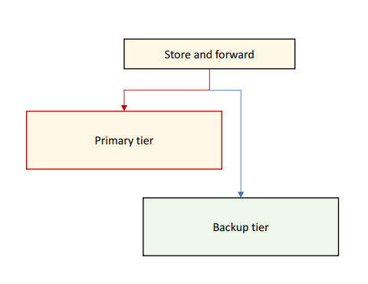
Reliability – Runtime
Self-healing architecture
Use store and forward
Use alternative system if:
Primary system is offline
Primary system is very slow
Primary output is invalid
Replay messages when external resources come back online

Slide 50
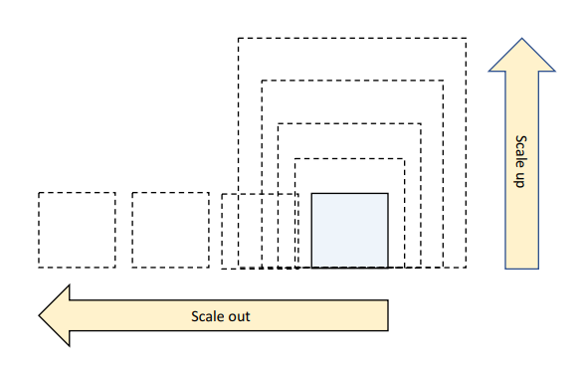
Scalability – Runtime
Adding computer resources without any interruption
Tier scaling:
Scale up – increate resources
Single point of failure
Scale out – duplicate tiers
For stateless applications
The better approach
Handle load spikes:
Async responses
Store and forward
Allow stale data

Slide 51
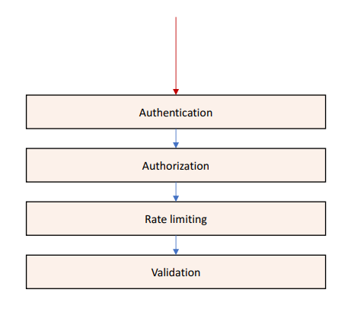
Security – Runtime
Authenticate & authorize clients
Validate input & output
Encrypt sensitive data
Protect against:
Spoofing
Malicious input & output
Malicious use
Data theft
DDoS attacks

Slide 52
System-wide considerations

Slide 53
General guidelines
Always think about the big picture
Consider the following questions:
How will the system work under heavy load?
What will happen if the system crashes at this exact moment in the business flow?
How complicated can be the update process?
There could be more depending on the specific requirements of the system
Main concerns for the system architecture are:
Loose coupling
Stateless
Caching
Messaging
Error Handling & Logging

Slide 54
Loose coupling on a system level
Making sure our services are not tightly coupled to other services
Every time we change one process, another needs to follow
A good idea is to be platform independent
Do not use Java-specific communication, for example
Because the other service should also be written in Java
Also, the services should be URL independent
Imagine multiple services like in a typical application
They all communicate with each other
If one URL changes – massive issues
Possible solution – yellow pages service used for discoverability
Consul is a great tool for that purpose
Another solution – a gateway service to route requests

Slide 55
Stateless applications
Super important for scalability and performance
The application's state should be stored only in two places
The data storage
The user interface
No state is stored in application code
Typically, the user-specific data is the application state
Make it stateless
Why it is important?
Scalability - scaling out will be super easy
Redundancy – if one server fails, the other continue to work

Slide 56
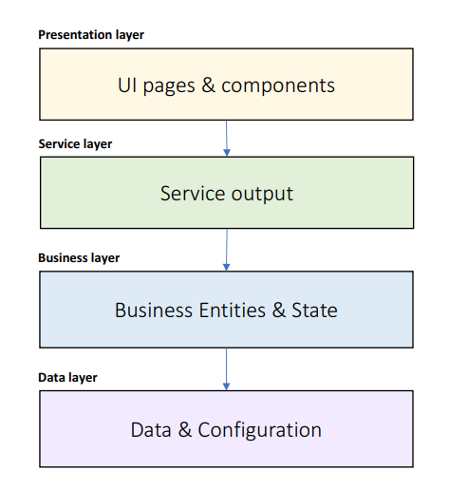
Caching – What To Cache?
UI pages
Mainly useful for seemingly static information
UI components
These parts of the page which do not change often
Service output
Business Entities
Business State
Data query results
Configuration data
List data to be cached in each layer

Slide 57
Caching – definition
Caching is bringing the data closer to its consumer so that its retrieval will be faster
Cache options:
Client-side cache – using headers to store data in the client's machine
CDNs – using a content-delivery network for static assets
Service cache – caching in the application code
Cache types:
In-memory cache – size is limited but easily implemented (static concurrent collection)
Distributed cache – data is stored in separate process, slower performance

Slide 58
Caching – Where To Cache?
Local memory
The fastest
State server
File system
Database
The slowest
User standard solutions:
Redis
Memcached
Framework-specific caches

Slide 59
Caching – How To Manage The Cache?
Expiration strategy:
Time-based
Event-based
Flush strategy:
Manual
Automatic:
Least Recently Used
Least Frequently Used
Priority

Slide 60
Caching – How To Fill The Cache?
Proactive loading
Static data
Known update frequency
Known size
Reactive loading
Volatile data
Unknown lifetime
Large data volume
Fast caching medium

Slide 61
Messaging – definition
Messaging is the communication between the various services
Messaging methods are not exclusive
You can mix them easily
Messaging criteria:
Performance – faster methods are preferred
Size – small or large messages
Execution model – blocking or asynchronous
Feedback – whether the message has failed
Reliability – a message will be received even if there was a problem
Complexity – development effort

Slide 62
Messaging – rest API
The standard for HTTP-based systems
Messaging criteria:
Performance – very fast
Size – same as HTTP limitations
Execution model – request/response – bad for long processes, blocking
Feedback – immediate feedback
Reliability – retry policy should be implemented, the circuit-breaker pattern is great
Complexity – extremely easy
Useful for traditional web applications

Slide 63
Messaging – real-time communication
Using HTTP Web Sockets
Publish/subscribe, push notifications
Socket.io, SignalR
Messaging criteria:
Performance – very fast
Size – limited, no more than a few KB
Execution model – web socket connection or long polling
Feedback – fire & forget
Reliability – complex to implement proper reliable solution
Complexity – extremely easy
Useful for chat, monitoring, and real-time data

Slide 64
Messaging – queue
Services do not communicate directly
The first service pushes to a message queue
The second service pulls from the message queue
Messages will be handled once and only once + in order
Messaging criteria:
Performance – not so good, database persistence involved
Size – unlimited, but keep it small
Execution model – polling
Feedback – excellent feedback
Reliability – very reliable
Complexity – requires training and setup
Useful for complex systems with lots of data

Slide 65
Exceptions – Exception Strategies
Allow to propagate
Catch and Re-throw
Logging
Retains stack trace
Catch, Wrap, and Throw
Add metadata
Expose consistent exception types
Catch and Discard

Slide 66
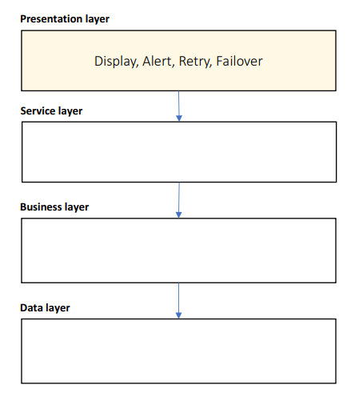
Exceptions – Presentation Layer
Catch, display, and discard
Other layers should never discard exceptions
Attempt to retry
Automatic 3 retries or manual
Switch to secondary system
Alert by Email, SMS, Slack…
Use meaningful messages
Business explanation
Technical information
Steps to resolve

Slide 67
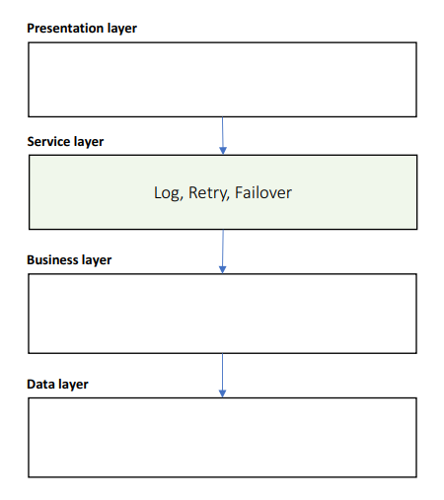
Exceptions – Service Layer
Catch and Re-throw
Attempt to retry
Switch to secondary system
Log exception and input message

Slide 68
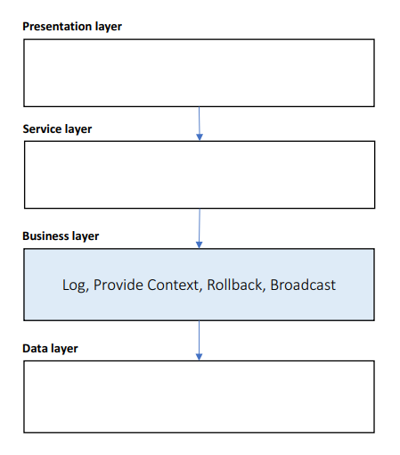
Exceptions – Business Layer
Catch, Wrap, and Throw
Use custom exception types
Provide business context
Rollback transactions
Log exception and input arguments
Broadcast to subscribers

Slide 69
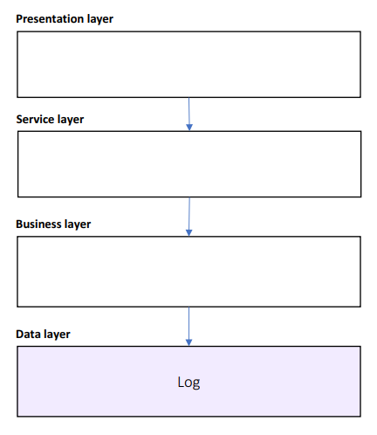
Exceptions – Data Layer
Catch and Re-throw
Log exception and input query

Slide 70
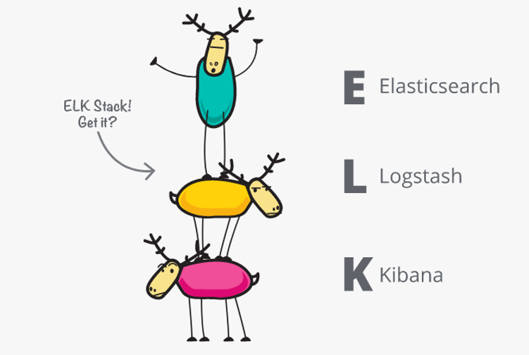
Logging - definition
Logging has two purposes:
Track errors
Gather data
Which module is most visited
Performance scenarios
User's flow
Log storage doesn't really matter
As long it is useful
Files
Database
Event log
Good architectures always includes logging and monitoring!

Slide 71
Logging – best practices
Use a central logging service
Same log format
Same log data
Same log location
Implementation:
Expose an API
Watch specific folders for log files and collect them
Tools like Logstash are perfect for that
Use Correlation ID
If you have multiple services in a flow
Make sure you can link different log entries
You can easily track a complete flow

Slide 72
System-wide attributes
The concepts we covered in this section are super important
They should be part of every single system out there
They allow you to have a fast, secure, reliable, and maintainable solution
Make all choices as informative and early as possible
Many concepts are difficult to replace once made
Changing a REST API with a message queue is not an easy and cheap task
These concepts are not exclusive
Although they are the most important ones
A lot of research should be done for every single system
No tool is a golden hammer

Slide 73
Deployment considerations

Slide 74
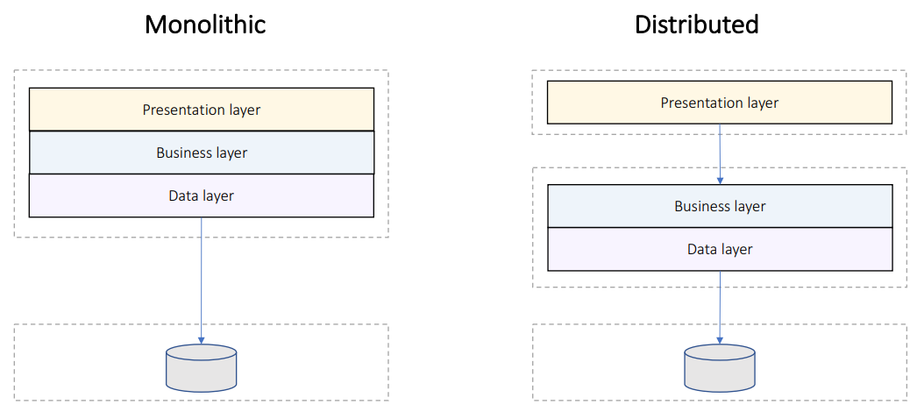
Deployment Models

Slide 75
Distributed Deployment Guidelines
Minimize blocking calls:
Async calls
One-way calls
Buffering
Use distributed transactions
Use coarse-grained interfaces
Manage state:
Stateless design – highly scalable
Stateful design – supports workflows but doesn’t scale
Shared state server

Slide 76
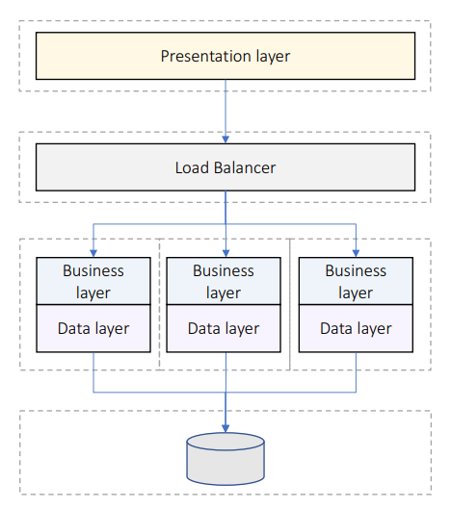
Deploy For Performance
Business/data layers scale out
Can detect failed tiers
Stateless design preferred
Stateful design requirements:
Shared state server
Session affinity

Slide 77
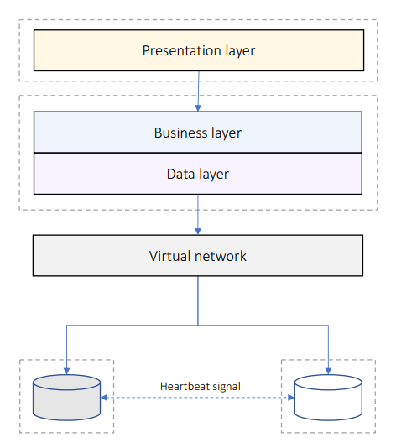
Deploy For Reliability
Secondary tier takes over when primary tier fails
Requires way more hardware
Synchronization considerations:
Sync when secondary tier activates
Or allow stale data

Slide 78
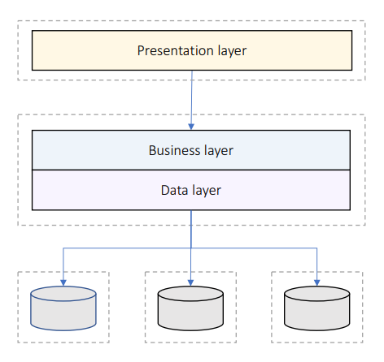
Deploy For Scalability
Data replicated on multiple tiers
Replication breaks consistency and atomicity
Consistency considerations:
Delayed sync in background
Or allow stale data
Or partition data

Slide 79
Scale Up And Scale Out
Scale Up
Easy with VMs or containers
But limited results
Scale Out
Requires layered design
Requires partitioned data
Potentially unlimited

Slide 80
Questions for the learning system
We still haven't thought about performance, availability, and scalability
1a. What is our tiering strategy? Scaling up or scaling out?
1b. What is our redundancy and failover strategy?
1c. Write down a load test and validate the scalability? What can we do to improve it?
2a. Is our business layer stateless? What is our state management policy?
2b. Think about all the data in our system. Where can we introduce caching?
2c. Where are we going to store the cache? How are we going to warm it up?
2d. Think about the exception policy for each layer. Consider a third-party logging tool?
3. Do you think you can easily debug problems in your solution? If no, redesign it.

Slide 81
The architecture document

Slide 82
Definition
Table of contents
The requirements of the system
Functional and non-functional
The technology stack
The architecture diagrams
And many more sections
Do not start development without this document!
Audience – almost everyone involved
Project manager
CTO / CEO
The Developers
The QAs

Slide 83
audience
Management
The requirements reflecting the essence of the system
Executive summary describing best practices and modern patterns
Architecture should be geared towards business goals
Management’s sections appear first
Development team
Technology stack
Modules, services, communication
Other technical details
QA team
Testing infrastructure
Servers, testing tools, coding

Slide 84
Format of the document
The format of the document is subject to hot debates
There are standards but nothing is set in stone
You can use UML, but it is not necessary
Sometimes you may skip it, if the audience is not familiar with it
Keep it as simple as possible
Use plain and simple English
Keep the technical details for the developers
Get into the minds of your readers
Visualize using software you are comfortable with

Slide 85
Main structure of the document
Background
The role of system from a business perspective
Requirements
These dictate the whole architecture
Executive Summary
High-level overview of the solution – for non-technical readers
Architecture Overview
The technical big picture of the solution
Module Drill-Down
The core of the document
Detailed and practical instructions for implementing the architecture

Slide 86
Background section
Describes the system from a business point of view
System's role
For example – solution for the HR team
Reasons for replacing an old system
For example – too much maintenance and old technologies
Expected business impact
For example – increasing HR productivity by at least 20%
Validates the architect's point of view of the system
Maximum 1 page
If there is an error, you can easily correct it
All next sections build upon this one
Boosts your confidence in front of the management
Therefore, you do not use any technical words here

Slide 87
Requirements section
This section should again be maximum 1 page
Keep it brief
Use bulleted lists for describing the requirements
Functional – what should the system do
Non-functional – what should the system deal with
Validates your understanding of the requirements
Whatever you design, it will solve the actual problem of the customer
The architecture is designed against well-defined requirements
It is a high-level overview of the requirements
Do not take the job of a functional analyst ☺

Slide 88
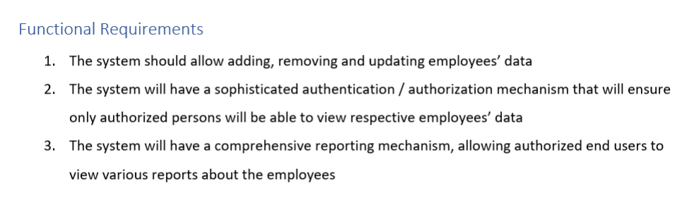
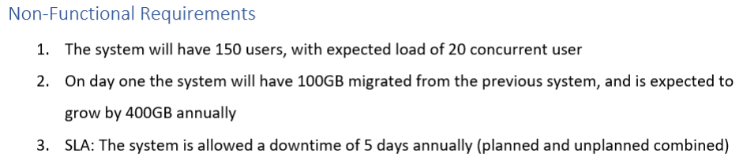
Requirements section example

Slide 89
Executive summary section
This section should be around 3 pages
This section is again for the management team
They will not read your whole document because usually they do not have the time
So, you need to impress them and present yourself as good solution architect
You need to make them believe that their system is in good hands
You need to provide a high-level nontechnical view of the architecture
Get into your readers' mind!
A person who does not have a lot of time available
He or she should be satisfied as quickly as possible with the presented solution
Use charts and diagrams (+ well-known technical terms)
Write this section after you write the rest of the document!

Slide 90
Architecture overview section
This section can reach up to 10 pages
Presents the architecture from a technical point of view
This section should not deep dive into independent modules
It just layers the foundation for these modules
Include these three subsections:
General description - type of the application and major non-functional requirements
High-level diagram – show the separate modules and their connections logically
Do not mix physical hardware here
Diagram walkthrough – describe various parts of the architecture and their roles verbally
Use simple words and include the most relevant details
Include technology stack here only if you use the same stack in each module

Slide 91
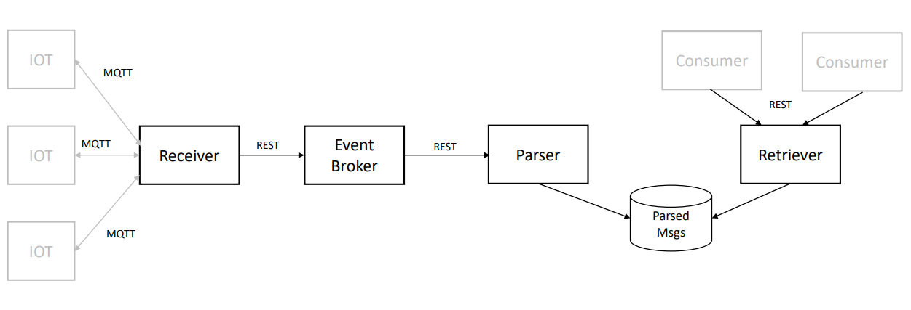
Architecture overview diagram example

Slide 92
Modules drill-down section
This section can have "unlimited" number of pages
You should add for each module in huge detail:
Component's role
Technology stack
Data store, back-end, front-end, etc.
Be extremely detailed here and always include rationale!
But only for the first module of a particular technology!
Module's architecture
The inner architecture of the module
What exactly and the module should do and how
Include layers, diagrams, design patterns, etc.
Describe the API and method names
Development instructions – keep it brief

Slide 93
designing a solution

Slide 94
Real-world project
In our previous sample project, we analyzed the process in a huge detail
And it was more of a demo project
Let us analyze a real-world application
Our project works with lots of IoT devices
Home cameras and thermostats, for example
Each of these devices has a separate application to control it
But we want to have a unified view of all our registered ones
We should collect status information and format the data to visually pleasing dashboard
This way the customer will know what is going on with all his/her devices

Slide 95
Functional requirements
For our first version the data is read-only and just visualized
Customers cannot update data directly from the application
Customers and their devices are pre-validated because of security protocols
Customers do not need to register in the application
Functional requirements
The Functional Analyst did a good job
We should understand the concept of the system
Receive status updates from IoT devices
Store the updates for future usage
Allow the users to query the updates

Slide 96
Non-Functional requirements
Think for a minute – what are the non-functional requirements of this system?
What information can influence our architecture?
What kind of questions we need to ask our customer?
What we know:
Messages are from IoT devices – there should be a huge amount of messages
What we should ask:
Load - how many concurrent messages should the system expect at peak times?
Volume - what is the total number of expected message per month?
Size – what is the average size of a message?

Slide 97
Client Answers
After a few days of thinking, the client answers:
Maximum 500 concurrent messages at peak times
15 000 000 total number of message per month
300 bytes is the average message size
Let's do some data volume calculations:
15 000 000 x 300 bytes = 4 500 MB / month
4 500 MB x 12 months = 54 GB / year
Almost every database can handle this volume of data easily
Usually in data extensive applications – the data can expire
But we do not think about data archiving or deleting here
Data volume doesn't seem to be a problem here

Slide 98
But what about load?
500 concurrent messages is a super busy system by any standard
We can easily add lots of servers and scale out
But such solution costs money
It is a better solution to design the software so that it can handle such load
There is one more concept we need to think about
Do we care about losing messages?
If we think about it – no. If a message is lost, a new one will be send in a couple of seconds…
Our system is quite tolerant for message lost
Of course, we are not talking about system-wide catastrophe
1 lost message out of 1000 is completely acceptable (99.9%)

Slide 99
users
The next requirement is about users
How many users will the system have?
Total of 2 000 000 users
How many concurrent users should we expect?
No more than 40 concurrent users
Users who are actively accessing the server
Total load calculated – 540 concurrent requests

Slide 100
Service level agreement
Of course, the client expects 100% uptime
But that is not possible in even the most advanced data centers
There are a lot of factors and we do not have control over them
Hardware, virtualization, network, database servers
In such cases – make sure you communicate with the proper people
When talking with the client, you can define three levels of software SLA
Silver, Gold, Platinum
You decide the differences but the best one is
Fully stateless
Easily scaled out
Logging & monitoring
We have live data here, so we choose the Platinum level

Slide 101
Requirements conclusion
Functional:
Receive status updates from IoT devices
Store the updates for future usage
Allow the users to query the updates
Non-functional:
Data volume: 54 GB annually
Load: 540 concurrent requests
Message loss: 0.1%
Total users: 2 000 000
SLA: Platinum level

Slide 102
Mapping baseline Modules
Modules are based on the requirements
We have two separate tasks working with separate entities
Receiving and storing status updates
Querying these status updates
We can distinguish two different modules
Receiver – to receive the messages
It will work on heavy load, so we need to make sure it will not have a thread starvation
Info Provider – to provide information to the end-users
But there is a question here…
Do we directly store the messages in a raw format?
Or do we validate them first?

Slide 103
Mapping baseline Modules
We ask the client, and the answer is:
There are 4 types of devices and formats
3 of them are JSON-based and one of them is a plain string (needs parsing)
Validation is required
We now know the receiver has the following tasks:
Receive the message
Validate the message
Parse the message and convert it to a unified format
Store the message
But the receiver is under heavy load, its request processing should be as fast as possible

Slide 104
Mapping baseline Modules
The parsing task is super important
It will make our data independent from its source
We will have easier queries for the dashboard
Having unified format is a good solution when data is from multiple sources
So, we decide to leave the receiver do just that – receive
For the other tasks – we need additional modules
We can add a Validation module to our architecture
But who should do the parsing? It is a good question…
Since validation and parsing always go hand in hand, we can do them in a single module
There is no justification to split the tasks in different modules for this scenario
Because they will require maintenance

Slide 105
Mapping baseline Modules
To summarize, we defined the following modules:
Receiver – receives messages and dispatches them
Handler – validates, parses and stores messages
Info Provider – gives us the option to query the messages
We can now add one more system-wide module:
Logging – the central logging service for all the other ones
Finally, we need a Data Store module
It should be shared between the Handler and the Info Provider

Slide 106
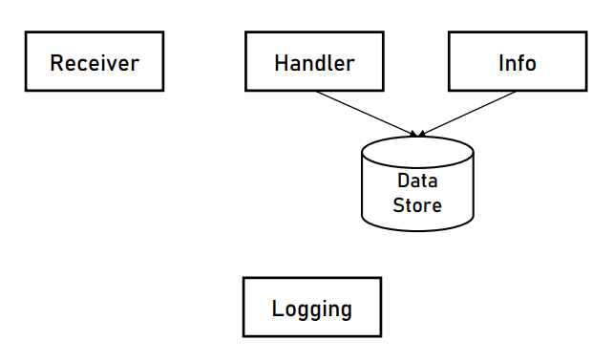
Choosing messaging methods
Our service modules look like this:
What kind of messaging is the right one between each one of them?

Slide 107
Choosing messaging methods
Let us begin with the Receiver:
It receives messages from the IoT devices but how?
We ask the client for device specification and we see that the IoT devices use HTTP POST requests – REST API then
But here is the tricky part. How to send the data to the Handler?
It should be done as quickly as possible to relieve the load of the receiver
The obvious mechanism here is a message queue
Provides us order of execution and reliability
If we use REST, we will block the working thread – it will be waiting for a response
Additionally, we will have to handle errors and glitches
Hurting the performance by a lot!
The fire and forget approach is perfect!

Slide 108


Choosing messaging methods
Popular queue options:
Self developed
Never developer your own message queue except in single-process applications
RabbitMQ
General purpose message broker
Easy to setup
Easy to use
Kafka
Stream processing platform
Perfect for data-intensive applications
Very complex installation and setup

Slide 109
Choosing messaging methods
What about Info Provider?
That one is easy – the answer is lies within the end-user requirements
How are they using the system?
Via a web browser
And web browsers use HTTP
The Info Provider will implement a REST API for the end-users
Last, but not least – the Logging service
We have large amounts of records – REST API will hurt the performance a lot
We could use file polling, but this solution is not cloud compliant and it is hard to control
We can use a database or a queue. Which one is better?
In this situation – a queue
Just because the database will be used as a queue in this scenario

Slide 110
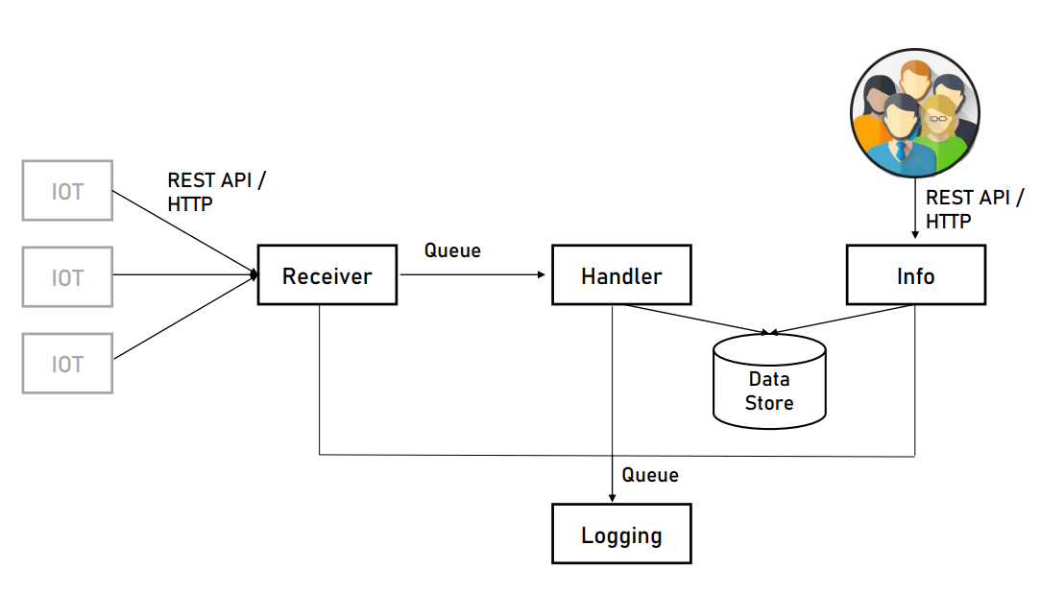
Choosing messaging methods

Slide 111
Designing the logging service
Our architecture is now ready!
Just make sure the client's IT support understands the queue mechanisms!
Our next task is to design the Logging service
It is super important, and it should be treated as a first-class citizen
Besides that – the other services need it
These are the steps:
Design the application type
Design the technology stack
Design the architecture

Slide 112
Designing the logging service
What are the tasks of the Logging service?
Read log records from the queue
Handle the log records
Save in log data store
The Logging service is not based on HTTP, so we do not need a web application
It is not a mobile or desktop application… But is it a console one?
Console is a good fit for long-running applications with limited UI
What about a service? Well, service is also a good fit
The choice is between a console or a service application
It depends on personal taste, so both are fine

Slide 113
Designing the logging service
Let us design the technology stack
Module's code and the data store
Access queue's API
Store data
All technologies provide a solution to these stacks, so we consider our developers' skills - .NET Core and SQL Server, for example
Any combination will work here – Java and MySQL, Python and PostgreSQL, etc.
For operations with lots of writes and less updates, we may consider a wide column or document database here

Slide 114
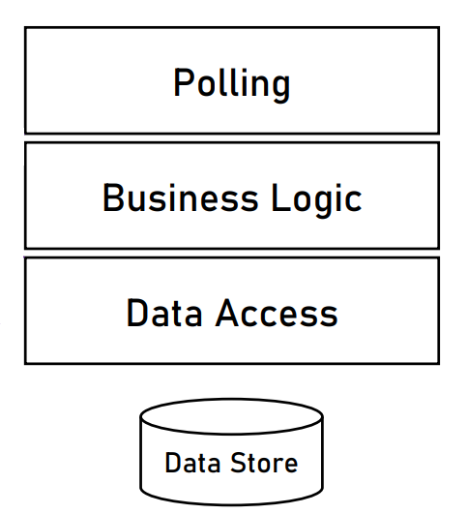
Designing the logging service
Let us design the service layers
Does the classical 3-tier architecture fit?
UI/Service interface
Business logic
Data access
It fits, but we do not have UI here, so let's change it a bit:
Polling
Business logic
Data access

Slide 115
Designing the logging service
We need to specify the responsibilities:
Polling – polls the queue every few seconds for new log records
Business logic – all new log records are sent here for validation
Data access – if everything is ok with the log records, this layer saves them to the database
Other developer instructions:
Use dependency injection – Microsoft.Extensions.DependencyInjection for our .NET case
Use ORM for data access – Entity Framework Core for our .NET case

Slide 116
Designing the Receiver service
What are the tasks of the Receiver service?
Receives messages from the IoT devices
Sends messages to the queue for the Handler
What kind of application is this service? It is an easy one – web application
What is the technology stack?
If we chose .NET Core for the Logging service, we need a very good reason to use another stack as it can create a lot of headaches
The question here is - does .NET Core support REST API?
Yes, it was built for that!
As a bonus point – we receive superb performance!
There is no reason to change the technology!

Slide 117
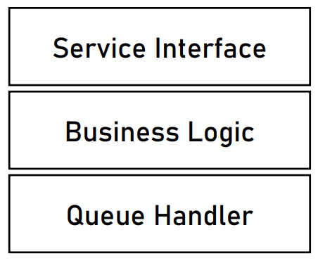
Designing the receiver service
Let us design the service layers
Does the classical 3-tier architecture fit?
UI/Service interface
Business logic
Data access
It fits, but we do not have a data store, so let's change it a bit:
Service interface
Business logic
Queue handler
With these two examples you can see why the layered architecture is so flexible!
Just work with interface contracts and you are great!

Slide 118
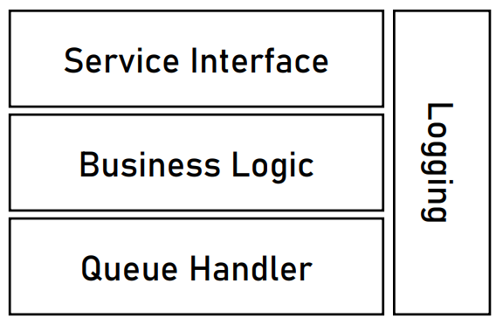
Designing the receiver service
There is one more thing here
We need a cross-cutting concern – logging!
It should receive logs from every single layer
Remember exception handling for the various separations?

Slide 119
Designing the receiver service
Let us look back at our non-functional requirements for validation
Two of the non-functional requirements are relevant here
Load is 500 concurrent messages. Are we compliant?
Yes! Our service is stateless, simple, and easily scaled out in front of a load balancer
Message lost is 0.1%. Are we compliant?
Yes! Our service is super simple and uses a reliable REST API protocol
As a side note – for a better uptime, we should consider a cloud technology
This service is done
We can add additional developer instructions about library usage, for example

Slide 120
Designing the Handler service
What are the tasks of the Handler service?
Polls messages from a queue
Validates messages
Parses messages
Stores messages in data store
What is the application type?
No HTTP and UI are required
A good choice is a service application
There are no special requirements so we can use the same technologies
.NET Core and SQL Server in our example

Slide 121
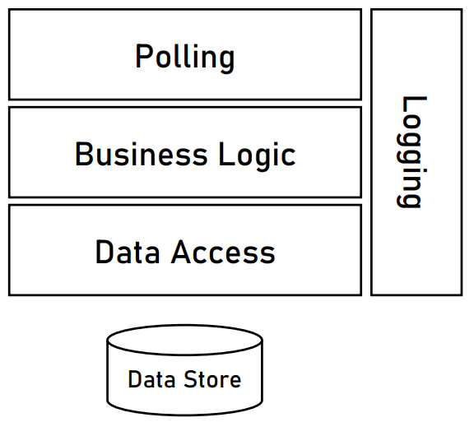
Designing the Handler service
Let us design the service layers
As with the Logging service, we do not need a service interface
So, our first layer will be named Polling
Because it polls data from the queue
For the Business Logic layer, we can add a plugin mechanism
To easily add validation and parsing logic
If new devices with new formats are added in the future
Of course, we need a cross-cutting concern - logging

Slide 122
Designing the Info provider service
What are the tasks of the Info Provider service?
Allows end-users to query the data store
The service is responsible only for data retrieval (it does not display the data)
The application type is easy
A web application with REST API
There are no special requirements so we can use the same technologies
.NET Core in our example

Slide 123
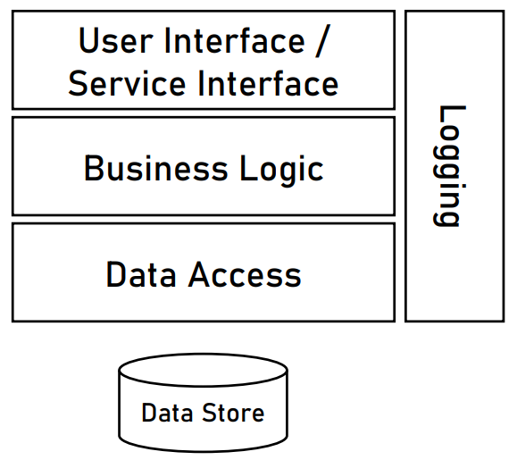
Designing the Info provider service
Let us design the service layers
Does the classical 3-tier architecture fit?
UI/Service interface
Business logic
Data access
Yes, it fits perfectly, just add logging!
But that is not all, we need to design the API
We did not do it in the Receiver service, because the method was dictated by the devices

Slide 124
Designing the Info provider service
After discussing with the client, the end-users need the following:
Current status of their entire house and for specific devices
Past events for their entire house and for specific devices
Required functionality:
Get all the updates for a specific house’s devices for a given time range
Get the updates for a specific device for a given time range
Get the current status of all the devices in a specific house
Get the current status of a specific device
The three main factors for our API are:
Path
Status code
Content

Slide 125
Designing the Info provider service
A sample functionality will be:
Get all the updates for a specific house’s devices for a given time range
The time range is not part of the path because it is not an entity
The status codes should be:
200 OK, if the data is successfully returned
404 Not Found, if the "houseId" could not be found
The response content should contain all the necessary information for the clients
GET /api/house/houseId/devices/updates?from=from&to=to

Slide 126
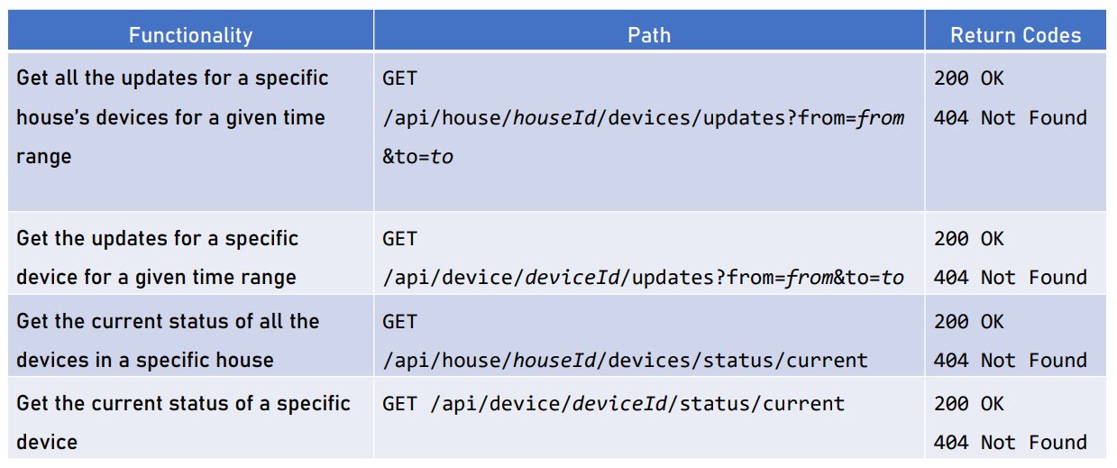
Designing the Info provider service

Slide 127
Writing the architecture document
We need to write an architecture document
Background
Requirements
Overall architecture
Module drill down
Executive summary
There is one provided in this workshop
Contains everything we discussed
You may use it as a template, if you like
We are done with this project! Great job!

Slide 128
what’s next?

Slide 129
Microservices
The microservices pattern is quite popular today
Basically, microservices mean logically distributed data
It comes with a lot of challenges and technical difficulties
It is a huge trend but do not board that train in a hurry
The big companies use microservices because they need them
Consider various other solutions first
And the best approach is to start with a domain-driven designed solution and extract microservices later when you need them
There is a bonus video in this workshop about microservices

Slide 130
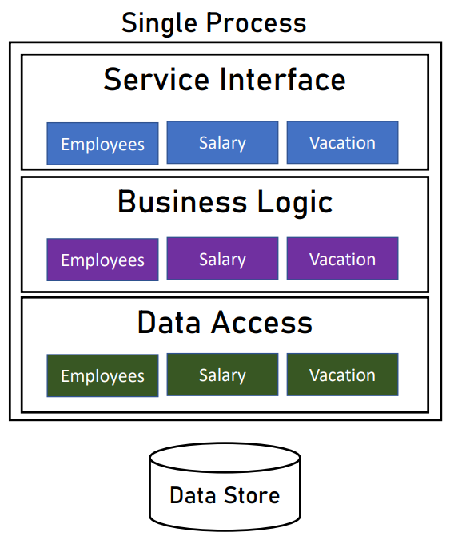
Microservices
In monolithic architecture:
A single exception may crash the whole process
Updates impact all the components
Limited to one dev platform
Unoptimized compute resources
With microservices:
Each service runs in its own process and does not impact other services
Each service can be updated separately
Each service can be implemented using different platform
Each service can be optimized separately

Slide 131
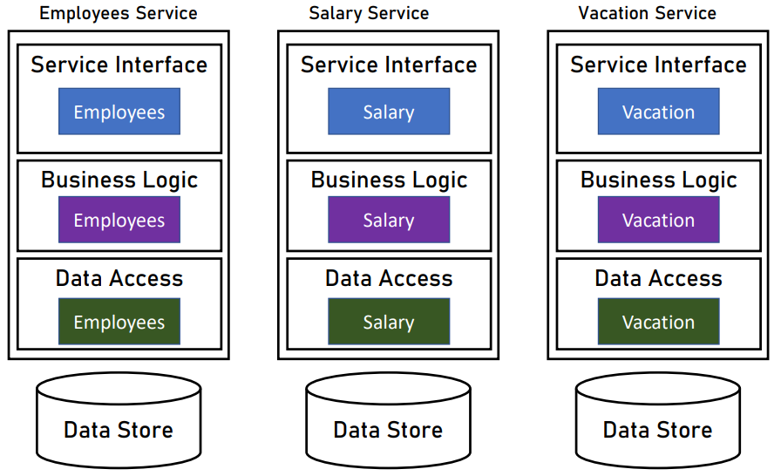
Microservices
Additional complexity:
Complex monitoring
Complex architecture
Complex testing
Complex deployment
Complex data consistency
You need eventual consistency patterns
Like the Outbox pattern
There is a bonus video about it

Slide 132
Event sourcing
Instead of updating entities, you save the update event and what was changed
Pros
Tracing – you can track everything quite easily
Data Model – super simple, no complex entities
Performance – changing state is add a small record
Reporting – a lot of business reports require data history
Cons
No unified view of entities – it takes time to build some visualizations
Storage – a lot of storage is required for all the data

Slide 133

Event sourcing
Mostly implemented where data history matters
Think about your bank account statement – you see events, not entities
Learn more about event sourcing
https://martinfowler.com/eaaDev/EventSourcing.html

Slide 134

CQRS
Stands for Command Query Responsibility Segregation
It means that we write data to one database
We read data from another
And there is a process to synchronize the two databases
Sounds strange at first, but it complements very well the Event Sourcing pattern
Useful with high frequency updates that require near real-time query capabilities for the price of complexity

Slide 135
Containers
Another great pattern is using containers
Docker is the most popular approach
You wrap your application in a read-only image
It gives you environment consistency and easier deployment
Containers often need orchestration
Docker Swarm or Kubernetes are great tools
There is a video lecture about Docker

Slide 136
Serverless computing
Emerged with the clouds
You may exclude the back-end development
And rely on deployed functions in the cloud
Allows easier scaling and implementation without an architecture
It is more difficult to debug
Azure Functions and AWS Lambda are great providers

